Slide 1
THE TRUTH ABOUT VACCINES
or
HOW TO DECREASE YOUR RISK OF SPENDING THE HOLIDAYS IN THE ICU
Steven A. Crawford, MD, DABFM, FAAFP
Professor Emeritus
OU College of Medicine

Slide 2
Discussion Overview
Review risks of some common vaccine-preventable diseases in adults
Review which common vaccines you should get NOW
Review why you should not get a vaccine
Review myths about the COVID

Slide 3
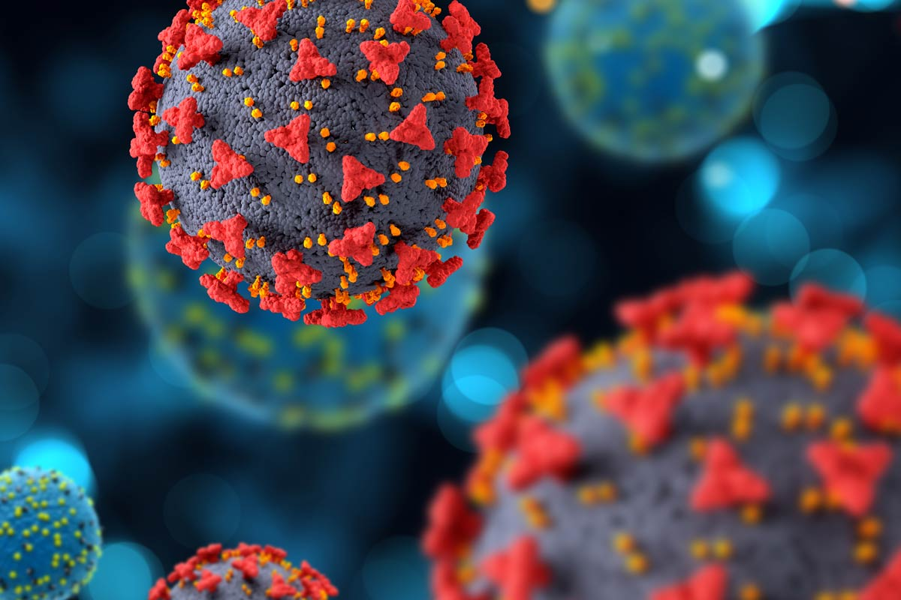
Risks of Vaccine-Preventable Diseases

Slide 4
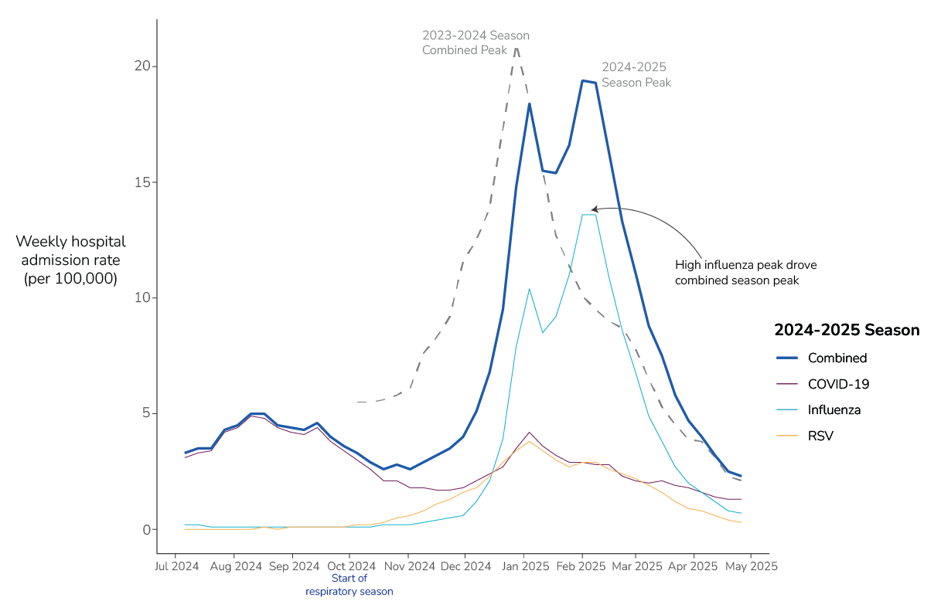
Respiratory Disease Forecast for 2025-2026

Slide 5
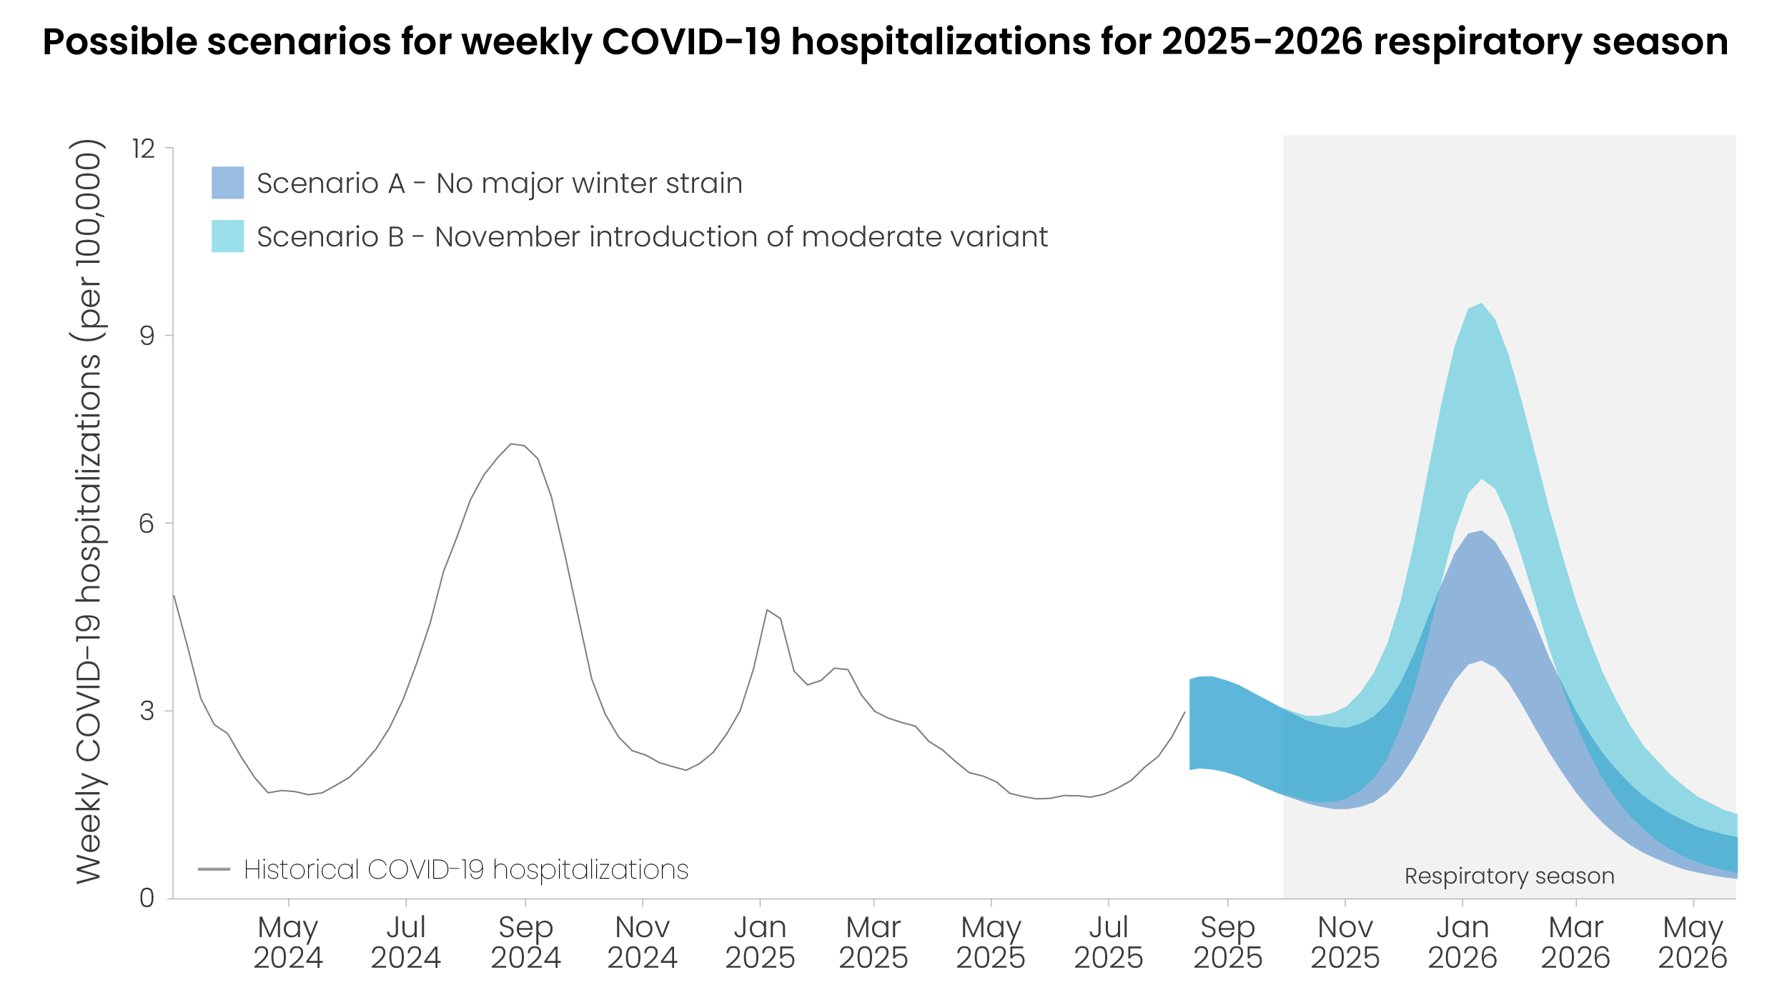
Respiratory Disease Forecast for 2025-2026

Slide 6
Risks of Vaccine-Preventable Diseases
COVID-19
  Around 15 million COVID-related illnesses last season
  Around 500,000 COVID-related hospitalizations last season
  Around 50,000 COVID-related deaths last season
Influenza (aka “the flu or the grip”)
  Between 15 – 60 million people are infected with the flu every season
  Between 120,000 – 800,000 people are hospitalized with the flu every season
  Up to 50,000 people die every season from flu-related complications
RSV (aka the croup or respiratory syncytial virus)
  Between 60,000 – 120,000 older adults are hospitalized with RSV annually
  Between 6,000 – 10,000 older adults die from RSV-related complications annually

Slide 7
Risks of Vaccine-Preventable Diseases
Pneumococcal-related diseases (aka “pneumonia”)
  500,000 older US adults get pneumococcal pneumonia annually
  30,000 older US adults get invasive pneumococcal blood infections annually
  150,000 hospitalizations in the US annually with the elderly more at risk of dying
  25,000 annual deaths in older adults are attributed to pneumococcal-related infections
Whooping cough (aka pertussis)
  Infants at greatest risk of hospitalization and deaths
  In the older adult, can cause severe, persistent cough that is not amenable to most medicines
Shingles (aka zoster)
  33% of all people will get shingles in their lifetime
  If you live to 85, 50% chance you will get shingles
  Older adults are more likely to face severe complications like long-lasting nerve pain (postherpetic neuralgia), hospitalizations, and even death

Slide 8
Risks of Vaccine-Preventable Diseases
Hepatitis B
  Contagious viral infection of the liver spread through contact with infected body fluids such as blood or semen
  Can lead to liver failure and liver cancer, yellow skin or eyes, stomach pain, vomiting, fever, diarrhea, fatigue, death
  Older adults have greater risk of chronic infection due to aging immune response
  Increased risk if diabetic & living in a group setting
Hepatitis A
  Contagious viral infection of the liver spread by contaminated food or drink or close contact with an infected person
  Can lead to liver failure, yellow skin or eyes, stomach pain, vomiting, fever, diarrhea, fatigue, death
  Greater risk when traveling to some foreign countries
Meningococcal disease
  Bacterial infection of the lining of the brain and spinal cord or the bloodstream
  Fever, headache, stiff neck, light sensitivity, confusion, loss of arm or leg, deafness, seizures, death
  Increased risk if you had had your spleen removed or have a spleen disorder

Slide 9
Risks of Vaccine-Preventable Diseases
Measles - very contagious viral infection that causes high fever, rash, cough, red eyes, and runny nose; spread through air and direct contact. Can cause brain swelling, infection of the lungs (pneumonia), and can be life-threatening especially for young children and babies or unvaccinated adults. With recent outbreaks, advisable to review your immunity with your clinician
Mumps - a contagious viral infection that causes fever, tiredness, swollen cheeks, and tender swollen jaw; spread through air and direct contact. Can cause brain swelling, painful and swollen testicles or ovaries, deafness, and in rare cases can be life-threatening
Rubella - a contagious viral infection that causes low-grade fever, sore throat, and rash; spread through air and direct contact. Rubella is usually mild in children but is very dangerous for pregnant women; can cause miscarriage or stillbirth, premature delivery, severe birth defects and can be life-threatening
Hib - a contagious bacterial infection of the lungs, brain and spinal cord, or bloodstream; spread through droplets in the air and direct contact. Depends on the part of the body infected, but can cause brain damage, hearing loss, loss of arm or leg, and can be life-threatening. Babies and children younger than 5 years old are most at risk for Hib disease in addition to those severely immunocompromised

Slide 10
Which vaccine should you consider getting NOW?
COVID-19, 2025-2026 version
Influenza, 2025-2026 version
Possibly
  RSV (or Respiratory Syncytial Virus)
  Pneumococcal (or the “pneumonia shot”)
  Tdap
  Zoster (or the “shingles shot”)
  Hepatitis B
  Hepatitis A
  Meningococcal
  MMR (measles, mumps, rubella)
  Hib (Hemophilus influenza B)
  mPox
  Special travel vaccines

Slide 11
Who should get a COVID-19 vaccine?
Everyone over 6 months of age should consider getting it
Strong YES for:
  All 65 years of age & older
  All 6 – 24 months of age
  All pregnant women
  Never received COVID-19 vaccine
  Certain “at risk” conditions
    Weakened immune system
    Diabetes, heart/lung disease
    Obesity (BMI > 30)
    Living in a long-term care facility
    Caring for someone that is high-risk

Slide 12
Which COVID-19 vaccine should I get?
All 4 protect against SARS-CoV-2 nearly equally
mRNA vaccines (code for the LP.8.1 Omicron strain’s spike protein)
  Codes for the whole spike protein
    Spikevax (Moderna)
      For people ages 6 months & older
      Uses 50 mcg dose
    Comirnaty (Pfizer/BioNTech)
      For people ages 5 & older
      Uses 30 mcg dose
  Codes for a small part of the spike protein
    mNEXSPIKE (Moderna)
      For those 12 years of age and older
      Uses 10 mcg dose
      This targeted vaccine allows for a smaller mRNA dose
Adjuvanted spike protein (spike) subunit vaccine (codes for the JN.1 Omicron strain)
    Nuvaxovid (Novavax) for people ages 12 and older
    Uses 5 mcg dose with a 50 mcg adjuvant

Slide 13
Should I get 2 doses of the COVID vaccine?
Most people only need one dose per season
People who are moderately to severely immunocompromised should consider getting 2 doses at least 2 m apart based on the clinical judgement of their healthcare provider
Previously unvaccinated children ages 6 – 23 months should get 2 doses of Spikevax a least 1 m apart

Slide 14
Who should NOT get a COVID-19 vaccine?
Received a COVID vaccine in last 2 months
Anyone who had an anaphylactic reaction (severe allergic reaction with hives and respiratory distress) to a previous dose of one of the currently available COVID-19 vaccines
  However, maybe able to receive the alternate type of COVID-19 vaccine (mRNA or protein subunit)
People with a moderate or severe acute illness should wait until they recover (including COVID infection)
Infants younger than 6 months of age
Several “precautionary” situations or conditions are noted

Slide 15
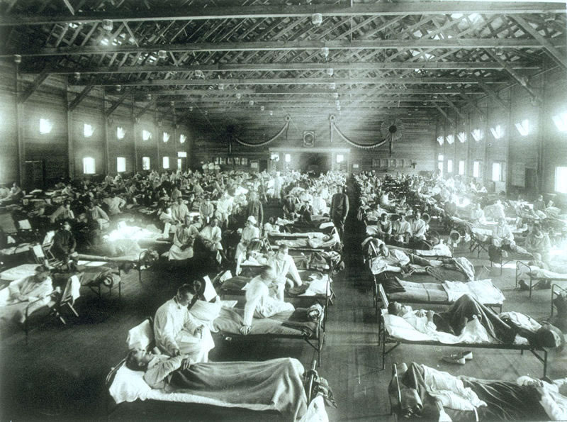
Who should get an Influenza vaccine?

Slide 16
Who should get an Influenza vaccine?
Everyone 6 months of age or older
Especially, anyone:
  65 years of age or older
    High-dose flu vaccine
    Adjuvant flu vaccine
  Caring for someone that is high-risk
  Living in a long-term care facility
  6 months – 2 years of age
  Pregnant
  Who is an American Indian/Alaska Native
  With certain medical conditions
    Weakened immune system
    Diabetes, heart/lung disease
    Obesity (BMI > 30)

Slide 17
Who should NOT get an Influenza vaccine?
Individuals with a severe, life-threatening allergy to a vaccine ingredient or a previous severe allergic reaction to a flu vaccine
  May be able to get alternate flu vaccine
  People with egg allergies can receive any appropriate flu vaccine without special precautions
People with a moderate or severe acute illness should wait until they recover
Those with a history of Guillain-Barré syndrome (GBS) within 6 weeks of a prior flu vaccination
Infants younger than 6 months of age

Slide 18
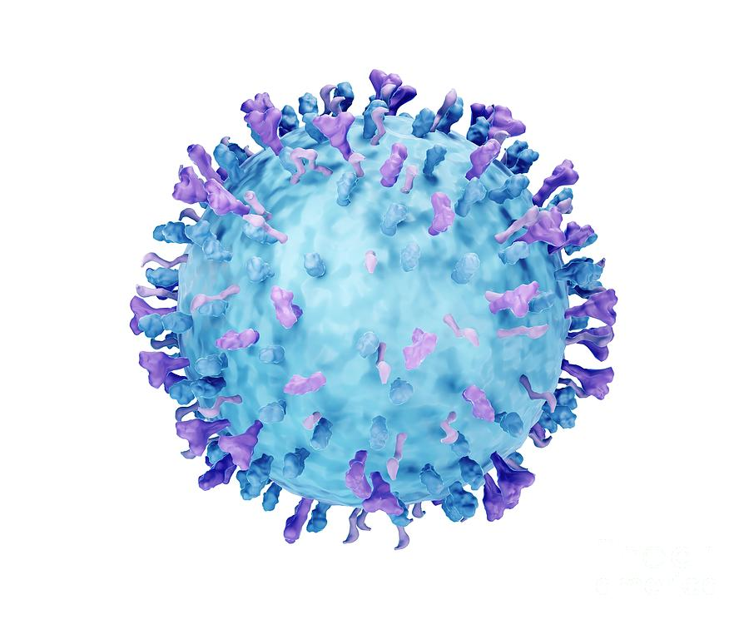

Who should get a RSV vaccine?

Slide 19
Who should get a RSV vaccine?
Everyone 75 years of age and older
Everyone 50 years of age and older with:
  Chronic heart or lung disease
  Weakened immune system
  Certain other medical conditions
  Living in a nursing facility
Special considerations for pregnant women

Slide 20
Who should NOT get a RSV vaccine?
If you got a previous RSV vaccine
If you had a severe allergic reaction to any component of the vaccine
People with a moderate or severe acute illness should wait until they recover

Slide 21
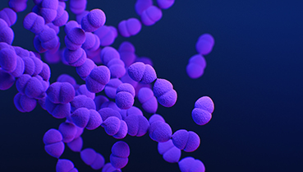
Who should get the Pneumococcal vaccine?

Slide 22
Who should get the Pneumococcal vaccine?
All aged 50 years and older
All aged 19-49 years of age with certain chronic medical conditions
All adults with weakened immune systems
All adults who have had their spleen removed or who have a spleen disorder
Native Americans & Alaska Natives

Slide 23
Who should NOT get the Pneumococcal vaccine?
Those who have had a severe allergic reaction to any component of the vaccine
Those who have had a severe allergic reaction to any diphtheria toxoid–containing vaccine
Those with a moderate or severe acute illness should wait until they recover

Slide 24
Common COVID myths
The COVID vaccines were developed too fast to be safe
  COVID-19 vaccines have undergone the most intensive safety analysis in US history
  COVID-19 vaccines continue to be monitored for safety, even after FDA approval, to make sure they continue to meet FDA's standards for safety & effectiveness
  As an example, these systems have identified anaphylaxis & myocarditis or pericarditis as serious types of rare adverse events following COVID-19 vaccination & appropriate actions were taken to advise clinicians & the public

Slide 25
Common COVID myths
The COVID vaccines were developed too fast to be safe
  Anaphylaxis risk – 1 in 5 million doses
  Myocarditis/Pericarditis – primarily associated with 2nd dose of mRNA vaccine occurring primarily in adolescent/young adult males with 80% recovering completely within 8 weeks
  Other rare events, such as Guillain-Barré syndrome (GBS), were (& are) also monitored for & studied
    GBS is rare neurologic disorder in which the body's immune system damages nerves causing muscle weakness & sometimes paralysis
    Risk was primarily associated with the J&J/Janssen COVID-19 vaccine, which is no longer available in the United States as of May 2023
  Thrombosis with Thrombocytopenia Syndrome (TTS)
    TTS causes blood clots and low platelets (blood cells that help with clotting)
    4 per one million doses after getting the J&J/Janssen COVID-19 vaccine only
    Higher rates among women ages 30-49 years (9-10 cases per million)
  Deaths
    Data shows that people who receive COVID-19 vaccines are less likely to die from COVID-19 or COVID-19-related complications than those who are unvaccinated

Slide 26
Common COVID myths
COVID-19 vaccines cause cancer or make cancer harder to treat
COVID-19 vaccines are not linked to a rise in cancer or more aggressive cancer
This myth may be passed along as one person's experience
Or rarely, as a personal observation by a healthcare professional.
Researchers looked at the large groups of people who got a COVID-19 vaccine, and found there is no evidence to support this myth

Slide 27
Common COVID myths
COVID-19 vaccines cause strokes
In January 2023, one vaccine safety tracking system noted a possible rise in stroke risk among people over age 65 who got a COVID-19 vaccine
The system, Vaccine Safety Datalink, is designed to quickly find patterns of concerns, also called sensitivity
But after expert review, no specific pattern or link was found between reporting a stroke & getting a COVID-19 vaccine
The databases that produced the statistical signal are early warning systems for rare events but do not prove cause
In this case, the signal was a false alarm

Slide 28
Common COVID myths
You can get COVID-19 from the vaccines
The Pfizer & Moderna COVID-19 vaccines only give your cells instructions how to make the COVID-19 surface protein using messenger RNA or mRNA
The Novavax vaccine contains one protein from the virus & another ingredient that boosts your immune system's response to the viral protein
Some people may have reactions to the vaccines, such as fever – a sign that your body is building protection against the COVID-19 virus

Slide 29
Common COVID myths
mRNA COVID-19 vaccines affect your DNA
mRNA (messenger RNA) COVID-19 vaccines cannot affect your DNA
These vaccines only give your cells instructions (the mRNA) how to make a protein found on the surface of the COVID-19 virus causing your body to make protective antibodies
Once the protein pieces are made, the cells break down the instructions & gets rid of them
The mRNA from the vaccine does not enter the nucleus of the cell, where your DNA resides

Slide 30
Common COVID myths
The Novavax protein subunit COVID-19 vaccine affects your DNA
This vaccine uses only the parts of the virus that stimulate your immune system
This vaccine also contains harmless S proteins that your immune system recognizes & helps stimulate a more robust immune response

Slide 31
Common COVID myths
Getting COVID-19 is better than getting a vaccine
Unless you have a history of having a severe allergic reaction to a previous COVID vaccine, getting a current COVID vaccine is less risky than catching the virus
Vaccines lower the health risk of getting a disease by stimulating your immune system to produce antibodies that clear out the germs faster in the future
Vaccine side effects can be planned for & are usually mild
Those who catch the COVID-19 virus instead of getting vaccinated may be at higher risk of post-COVID-19 syndrome (long COVID)
Getting a COVID-19 vaccine after recovering from COVID-19 may give you better protection than just the vaccine or just the infection

Slide 32
Common COVID myths
Hot or cold temperatures will keep me from getting COVID-19
The virus that causes COVID-19 spreads mainly from person to person
The virus spreads when other people breathe in infected droplets or when the droplets land in their eyes, noses or mouths
It is a myth that hot or cold temperatures can keep you from catching the COVID-19 virus
People all over the world, in winter and summer, get COVID-19

Slide 33
Common COVID myths
Special foods, drinks, or supplements prevent or treat COVID-19
Adding hot peppers or garlic to your diet or drinking alcoholic will not protect you from getting COVID-19 or treat the disease
Dietary or herbal supplements are not recommended to prevent or treat COVID-19
Colloidal silver supplements are not safe or effective for treating any disease
Oleandrin, an extract from the toxic oleander plant, is poisonous & should not be taken as a supplement or home remedy for any reason

Slide 34
Common COVID myths
Using disinfectant chemicals on or in my body will prevent or treat COVID-19 infections
When applied to surfaces, disinfectants can help kill germs such as the COVID-19 virus.
But it is dangerous to use disinfectants on your body, inject them into your body or swallow them
Spraying alcohol or bleach on your body will not kill viruses that have entered your body
These substances also can harm your eyes, mouth and clothes
Disinfectants can irritate the skin & may be toxic if swallowed or injected into the body
Also, do not wash produce with disinfectants

Slide 35
Common COVID myths
“Special” medicines are better at preventing and treating COVID
Ivermectin
  Does not treat COVID-19 infections
  It treats or prevents certain parasitic infections in animals & humans
  Taking large doses of this drug can cause serious harm
Hydroxychloroquine & chloroquine
  Are primarily used to treat malaria
  Early in the pandemic, when no treatments existed, the FDA authorized these medicines for emergency use due to some early, small favorable studies
  But the FDA withdrew that authorization when larger clinical trials showed that they were not effective for treating COVID-19 & can also cause serious heart problems
Zithromycin or Z-paks, Amoxicillin, and others
  Are not effective against viruses, including COVID-19
  They target another type of germ called bacteria

Slide 36

Questions?

